Slide 1

Balanced scorecard slide 1
Sequence Classification

Slide 2
Balanced scorecard slide 2
The Problem
The Goal
The committee that determines who enters the Basketball Hall of Fame is not transparent about how those decisions are made. This makes it challenging to predict which current or recently retired players will make it, especially those on the edges.
Predict if a player will or should be a hall of famer
Determine which metrics are the strongest indicators of a hall of famer

Slide 3
Balanced scorecard slide 3
The Data
Traditional and Advanced metrics for each player by season
Missing subjective features like all star/all-nba selections
Does not include playoff accomplishments (i.e. number of championships)
Note: Hall of famers an not be inducted until 3 years after they retire
While cleaning:
For time’s sake I dropped rows with na’s, which was all seasons before ~1980
I dropped players with less than 5 seasons
I looked at the first 20 seasons for each player and entered 0s for players who didn’t player 20 seasons
Name | FGM_1 | FGA_1 | … | FGM_2 | FGA_2 | … | FGM_20 | FGA_20
Michael Jordan
Lebron James
FGM | FGA
FGM | FGA
FGM | FGA
FGM | FGA
FGM | FGA
FGM | FGA
FGM | FGA
FGM | FGA

Slide 4
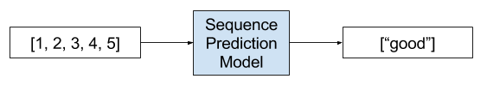
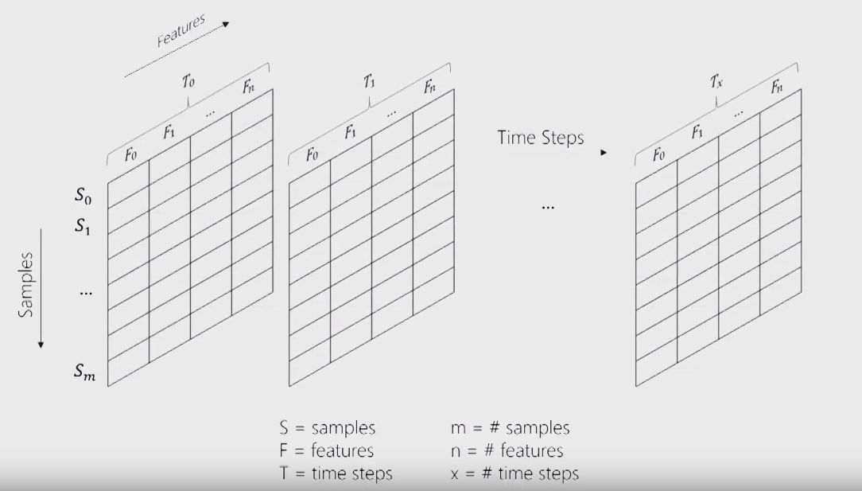
Balanced scorecard slide 3
Sequence Classification
LSTM

Slide 5
Helpful Resources
https://www.youtube.com/watch?v=flMCYqIn3eg (Walk through of solving a time series problem with sequence classification)
https://machinelearningmastery.com/sequence-prediction/
https://machinelearningmastery.com/reshape-input-data-long-short-term-memory-networks-keras/
https://machinelearningmastery.com/sequence-classification-lstm-recurrent-neural-networks-python-keras/

